Slide 1




Linear Regression from Scratch
Predicting CO₂ Emissions with Pure Mathematics
Project 23 — Linear Algebra for Computer Science
German International University
Instructor: Dr. Doaa Elsakout
Year: 2025/2026

Slide 2





Why CO₂ Emissions Matter
Youssef
Transport accounts for a major share of global emissions; predicting vehicle CO₂ supports sustainability decisions.
Emissions depend on engine characteristics
Prediction enables policy/standards, consumer awareness, and fleet planning
CO₂ prediction model
Decision impact
Vehicle specs
(policy / product / consumer)
02

Slide 3
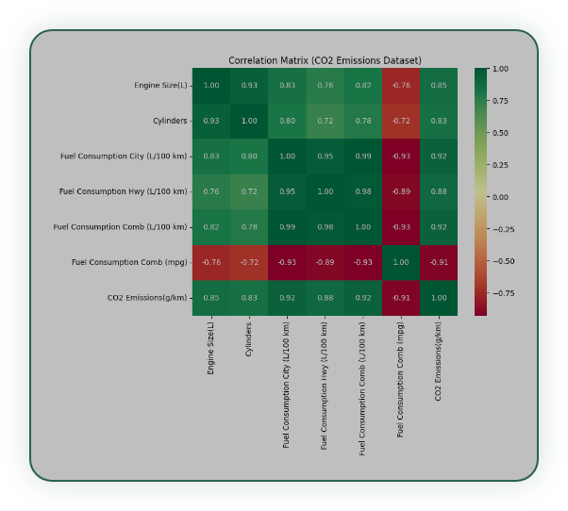




Real-World Data: Canadian Vehicles
Hassan
Dataset
~7,385 vehicle records
X
Features
Engine Size (L), Cylinders
y
Target
CO₂ emissions (g/km)
Two intuitive features can explain a meaningful portion of emission variance.
03

Slide 4








Linear Algebra Foundations
Fouad
Vectors & Matrices
Matrix Representation
Representing data as X (features), y (targets), and w (weights).
y
=
X
w
+
b
Target = Features × Weights + Bias
Minimizing Error
Finding the optimal weights to reduce the difference between predictions and actual values.
Data → Line Fit
Least Squares Concept
Minimizing the sum of squared residuals to find the best-fitting line.
04

Slide 5










Normal Equation
Mark
Matrix Multiplication Flow
Direct closed-form solution
Compute once, get optimal weights.
XT
X
Inverse ( )-1
Formula
XT
y
w
=
(XT X)-1
XT
y
w
05

Slide 6


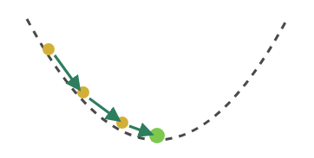






Gradient Descent
Omar
Formula
w
=
w
-
α
·
XT(Xw - y)
Step-by-Step Descent
Iterative Optimization
Gradually updates weights step-by-step to find the minimum error.
Key Parameters
Learning Rate (α) Impact
Requires tuning the learning rate (α) and setting the number of iterations for convergence.
Too Small
Optimal
Too Large
06

Slide 7



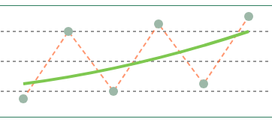






Ridge Regression
Khaled
L2-Regularized Solution
Adds a penalty term to the loss function to constrain weight magnitudes and improve model stability.
Regularization Effect
Formula
Overfit (λ=0)
Regularized
w
=
(XT X + λI)-1
XT
y
λ Tuning Impact
Prevents Overfitting
λ → 0
Optimal λ
λ → ∞
The regularization parameter λ controls the trade-off between fitting training data and keeping weights small.
Overfitting (High Variance)
Balanced Model
Underfitting (High Bias)
07

Slide 8









Engineering the Solution
Roshdy
Tools
Key decisions
Prefer np.linalg.solve() over explicit inverse
NumPy
Normalize features for gradient descent
(core math)
Exclude bias term from Ridge regularization
pandas
(data handling)
1
2
3
4
5
matplotlib
(plots)
Data
Preprocess
Train (3 methods)
Evaluate
Validate
sklearn
(validation only)
8

Slide 9



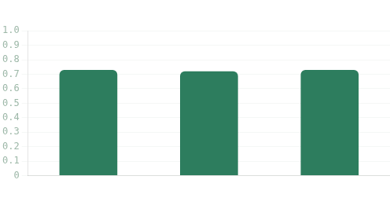
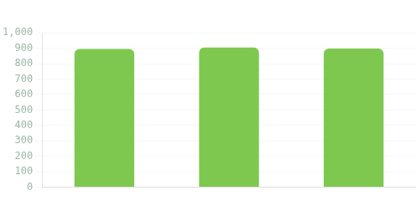
All Methods Agree
R² Score
MSE
Predictions within
Weight diff vs sklearn
≈ 0.72–0.73
≈ 900
~30 g/km
≈ 10⁻¹²
9

Slide 10

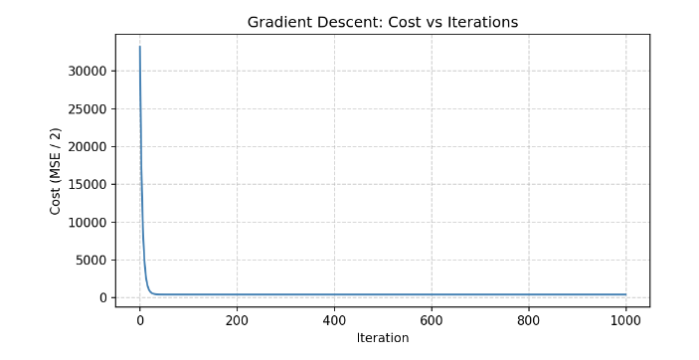


Watching the Model Learn
Carlos
Rapid error drop, then stable convergence.
Rapid learning phase
Convergence plateau
10

Slide 11

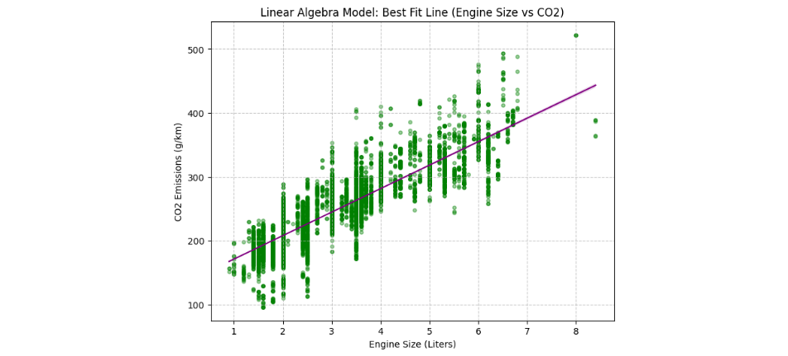
From Math to Reality
Insight: A simple linear model produces practical accuracy (≈ ±30 g/km).
11

Slide 12




What We Learned
Mohamed
Mathematical Truth
Practical Insight
Real-World Impact
Linear algebra fundamentals are sufficient to build regression end-to-end
From-scratch weights match sklearn (≈ 10⁻¹² difference)
Emission predictions support sustainability decisions
Green AI impact
12

Slide 13






Thank You
Questions?
Directed by Mark Tamer
Ahmed Roshdy
Khalid Osam
Omar Shaker
Yousef Hany
Mark Tamer
Hassan Eslam
Carlos Emad
Mohamed Elsayed
Repo Link
Ahmed Fouad

